Slide 1
Exploration to the New World

Slide 2
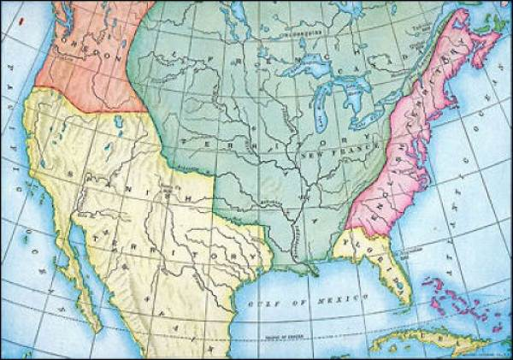

Slide 3
With Queen Mary’s death in 1558,
there was controversy over
whom should rule. Elizabeth,
the younger daughter of
Henry claimed the throne.
She was only 25 years old.
However, she ruled England
for 45 years and had a lasting
impact on the country.

Slide 4
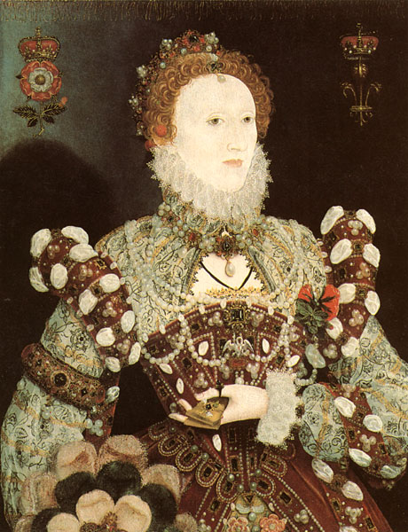
When she took
over the throne,
there was major
tension between
Catholics and
Protestants. The
treasury was
nearly empty,
and Spain was a
huge threat.

Slide 5
However, she made great
changes for her country:
She unified a Protestant England
She brought in and supported the
Renaissance Age of literature
and music
She brought England into competition
as a world power.

Slide 6
Very importantly, she was
responsible for English
exploration of the New World.

Slide 7
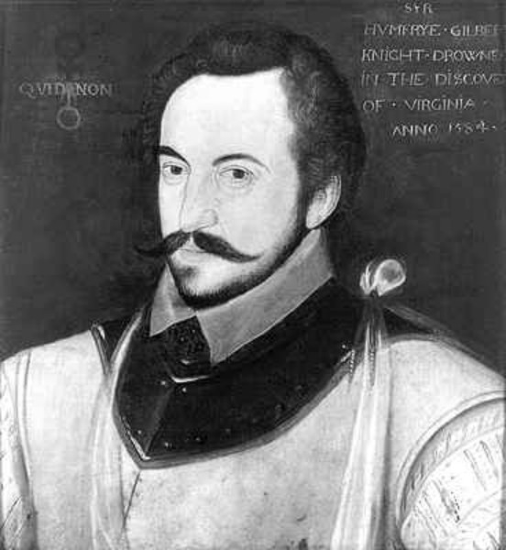
Sir Humphrey
Gilbert went
out looking for
lands to claim
for England.
England had to
get a foot in
the door after
Columbus’s
discovery.

Slide 8
Sir Humphrey found (and
claimed) Newfoundland
for England. Tragically, he
died in a shipwreck while on
his way back home in 1583.

Slide 9
One of Elizabeth’s
favorites and the half-
brother of Sir Humphrey
was Sir Walter Raleigh.

Slide 10
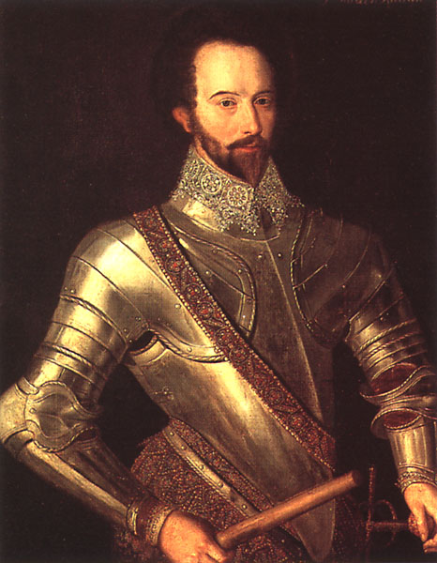
Devastated by
his brother’s
death, he wanted
to continue what
his brother had
started.

Slide 11
Raleigh sent men out to
further explore this new
land. Three attempts were
made to establish a settlement
off the coast of North
Carolina (Roanoke Island). Queen
Elizabeth wanted this new land
named after her -Virginia (the
virgin queen).

Slide 12
The last attempt was made
in 1587. A group of settlers
(men, women, and children),
sailed to Roanoke to create
a settlement for England.
Low on supplies, their leader,
John White, headed back to
England to stock up.

Slide 13
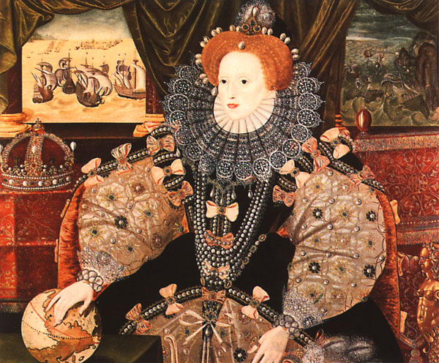
His timing was
not good. A
naval war was
about to break
out against
Spain. Elizabeth
would not allow
White to take
a ship back to
Roanoke.

Slide 14
Importantly for England,
its navy defeated the
Spanish Armada in 1588.
This defeat marked the
beginning of Spain’s fall
from world power. It gave
England the chance to take
the title.

Slide 15
Yet, White couldn’t get back
to Roanoke until 1590. When
he arrived at the settlement,
all of the people were gone.

Slide 16
It remains a mystery
today what happened to
the settlers at Roanoke.

Slide 17
Seventeen years later,
another attempt was made
to settle in Virginia. This
time, the settlers chose
a marshy area at the mouth
of the James River. They
called this settlement, Jamestown
after their new king, James I.

Slide 18
Although this settlement
almost failed too, after a
few very tough years, it
stabilized and became
known as the first permanent
settlement for England.

Slide 19
It lasted until Bacon’s
Rebellion in 1676. Bacon
burned down the settlement.
At that time, many people
had already moved inland to
better land and less disease.
A new city was soon created
known as Williamsburg. It grew
to be the most important city in
the colony of Virginia.

